Slide 1
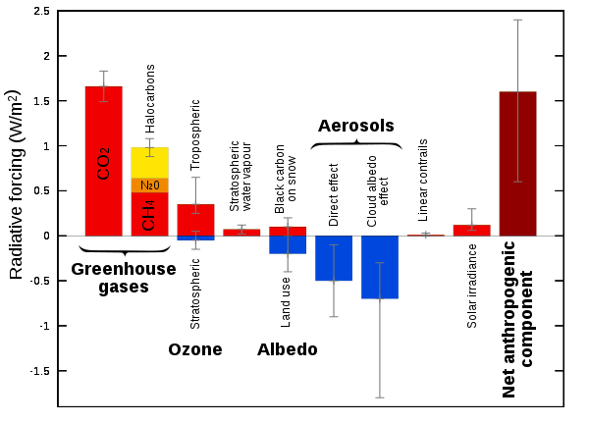
Recap: anthropogenic radiative forcings
Forcings of GHGs are all positive, of course. CO₂ is a very long-lived forcing (it stays in the atmosphere for 100s of years).
The forcing due to albedo reduction we talked about before is also on the order of 1-2 W/m²)
There are negative forcings too, which have been protecting the planet from overheating. Unfortunately, those are all short-lived (a few years) hence Hansen’s Faustian Bargain.
Either way, the long-term effects of these forcings should be multiplied by feedback factors that we will have to deal with eventually.

Slide 2
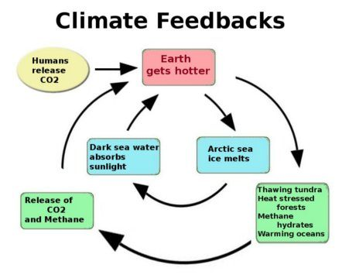
Feedback loops

Slide 3

Feedback loops
$$∆T=∆T_{GHG}$$

Slide 4


Feedback loops
$$∆T=∆T_{GHG}×(1+ f)$$
$+∆T_{GHG}$ $× f$
$f$ has to be less than 1

Slide 5

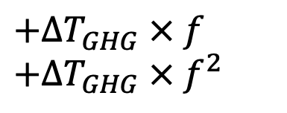
Feedback loops
$$∆T=∆T_{GHG}×(1+ f+f^{2})$$
$+∆T_{GHG}$ $× f$
$+∆T_{GHG}$ $× f^{2}$
$f$ has to be less than 1

Slide 6

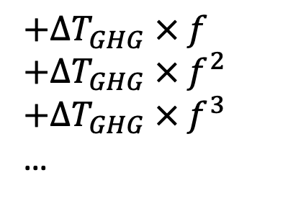
Feedback loops
$$∆T=∆T_{GHG}×(1+ f+f^{2}+f^{3}+…)$$
$+∆T_{GHG}$ $× f$
$+∆T_{GHG}$ $× f^{2}$
$+∆T_{GHG}$ $× f^{3}$
…
$f$ has to be less than 1

Slide 7
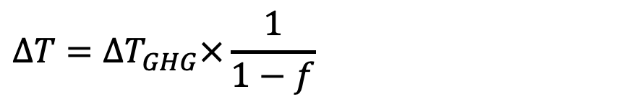
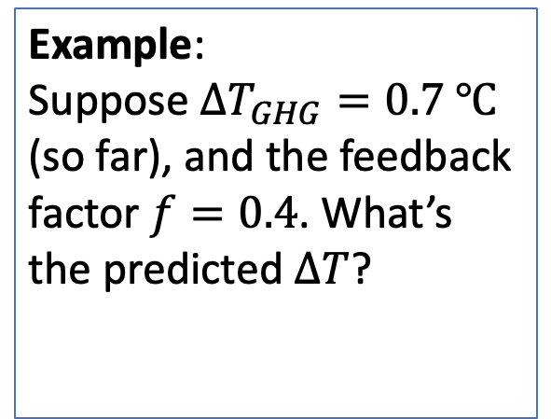
Feedback loops
$$∆T=∆T_{GHG}×\frac{1}{1−f}$$
$+∆T_{GHG}$ $× f$
$+∆T_{GHG}$ $× f^{2}$
$+∆T_{GHG}$ $× f^{3}$
…
Example:
Suppose $∆T_{GHG}=0.7 ℃$ (so far), and the feedback factor $f=0.4$. What’s the predicted $∆T$?
$f$ has to be less than 1

Slide 8

Feedback loops
$$∆T=∆T_{GHG}×\frac{1}{1−f}$$
$+∆T_{GHG}$ $× f$
$+∆T_{GHG}$ $× f^{2}$
$+∆T_{GHG}$ $× f^{3}$
…
Example:
Suppose $∆T_{GHG}=0.7 ℃$ (so far), and the feedback factor $f=0.4$. What’s the predicted $∆T$?
$∆T=1.2℃$
$f$ has to be less than 1

